Slide 1

Project 2 Numerical Reservoir Simulation
SUMMARY OF RESULTS
Prateek Bhardwaj
pb22734

Slide 2
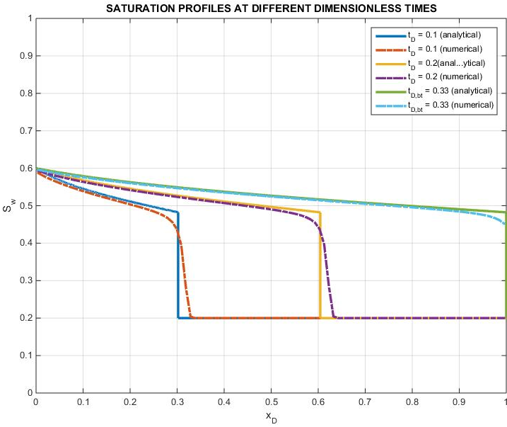
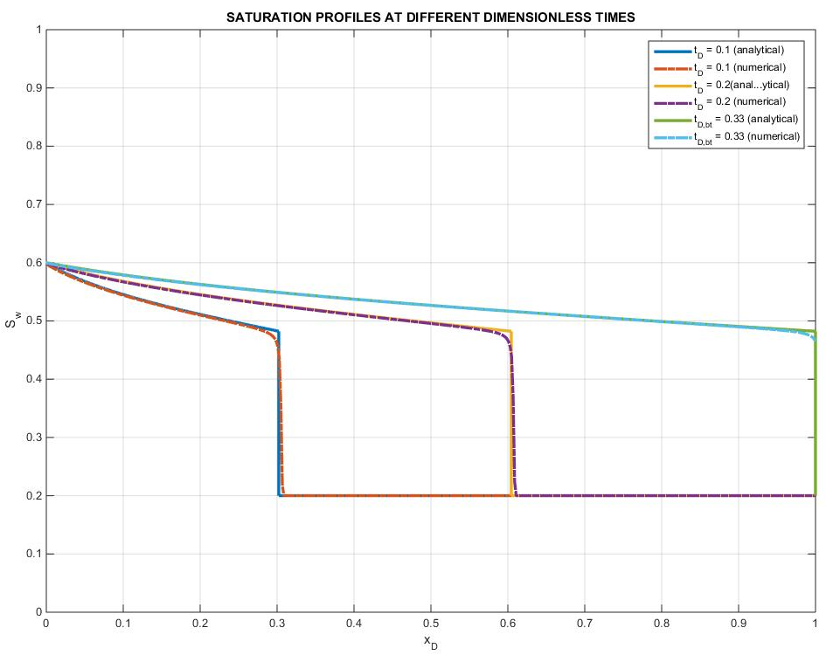
Multiphase Model Validation
%PrateekBhardwaj_BuckleyLeverett.m
Delta X = 5ft
Delta X = 1ft
The slight difference at the sharp shock front is due Numerical dispersion effects, which can be reduced by considering smaller grid blocks or a refined grid which gives more accurate comparison to the analytical solution.

Slide 3
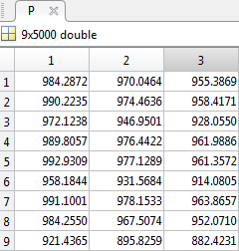
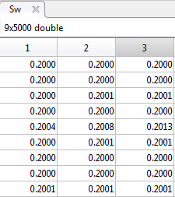


3x3 Case Comparision
% PrateekBhardwaj_3x3.m
Provided solution
t=0 days
t=0.1 days
t=0.2 days
t=0.3 days
t=500 days
Obtained solution

Slide 4
Application problem
Function Files
%PrateekBhardwaj_Nechelik.m
%relperm.m : Gives relative permeabilities of oil and water for a given Sw
%pcap.m : To initialise the reservoir saturations bsaed on capillary pressure
%capillary.m : To determine the capillary pressures at a given saturation
%PVTproperties.m : Oil pressure dependent viscosity, compressibility and FVF
%trans.m : To calculate the 4 transmissibilities associated with each grid block
%Wells.m : Returns Q, J and well properties
%UserInput.m : Input File, the only file needed for modification
%TDG.m : Calculates and assings the T, D,and G matrices based on fluid
%plotting.m : Post processing

Slide 5
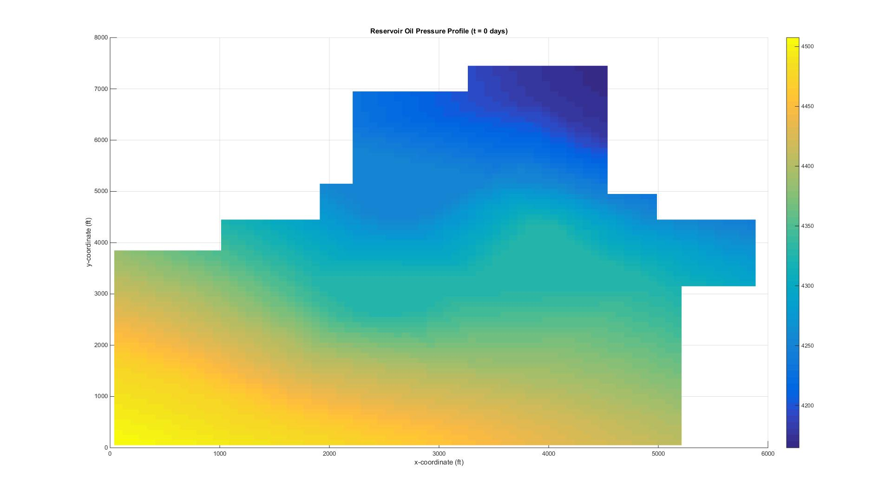
Pressure Profile @ 0 days
% PrateekBhardwaj_Nechelik.m

Slide 6
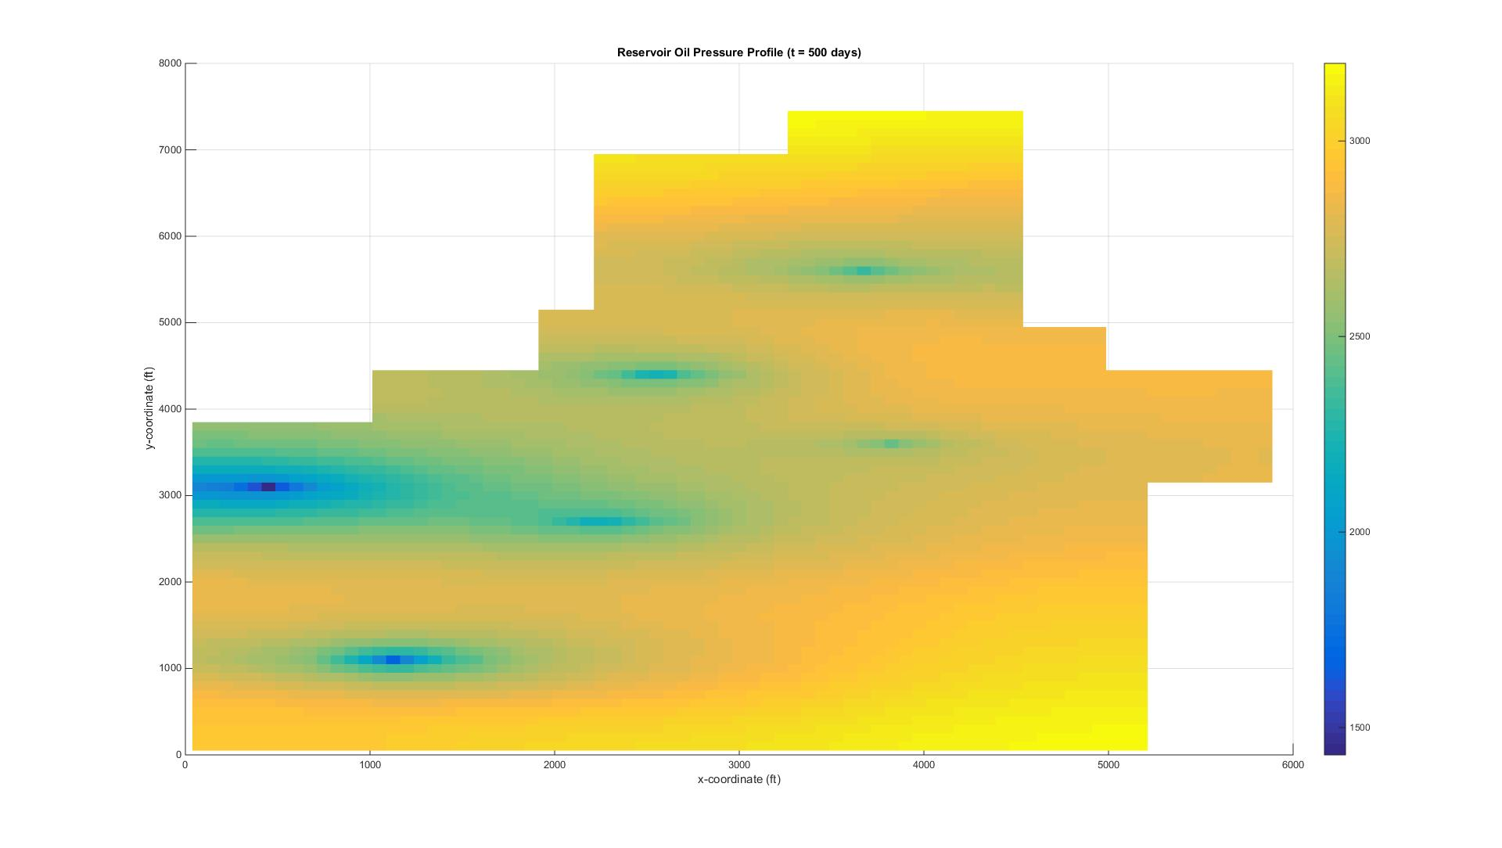
Pressure Profile @ 500 days
% PrateekBhardwaj_Nechelik.m

Slide 7
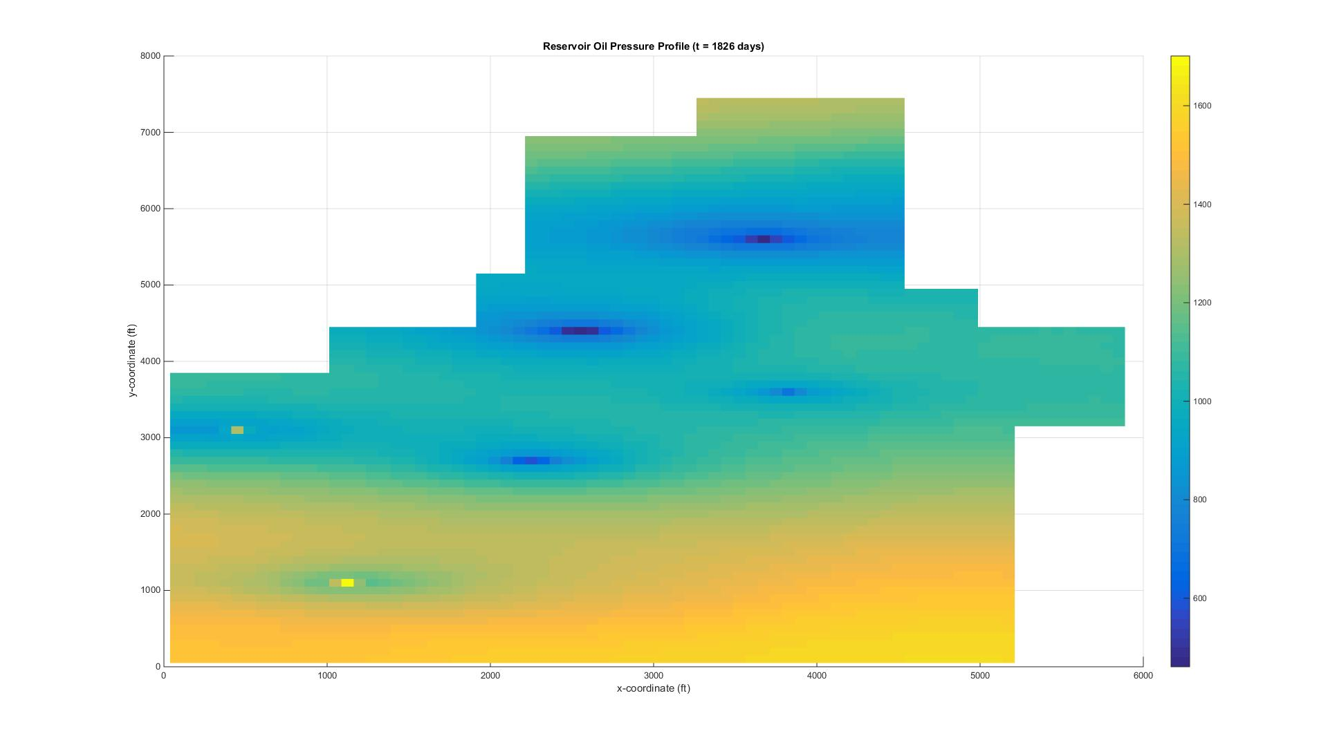
Pressure Profile @ 1826 days
% PrateekBhardwaj_Nechelik.m

Slide 8
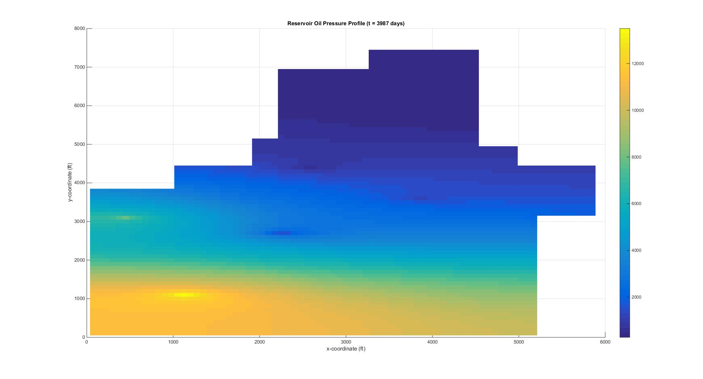
Pressure Profile @ 3987 days
% PrateekBhardwaj_Nechelik.m

Slide 9
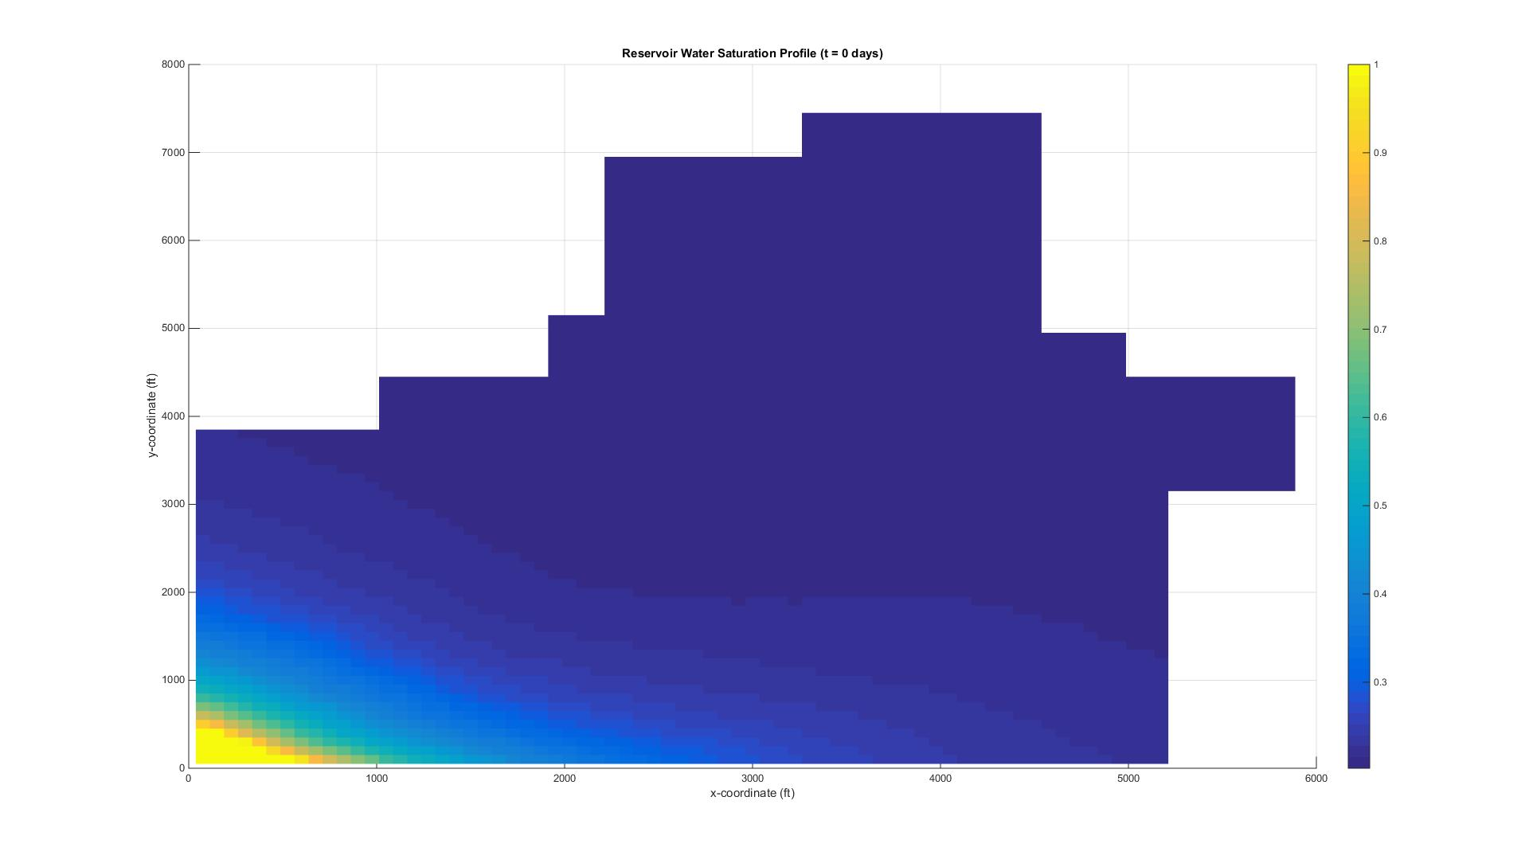
Saturation Profile @ 0 days
% PrateekBhardwaj_Nechelik.m

Slide 10

Saturation Profile @ 500 days
% PrateekBhardwaj_Nechelik.m

Slide 11

Saturation Profile @ 1826 days
% PrateekBhardwaj_Nechelik.m

Slide 12
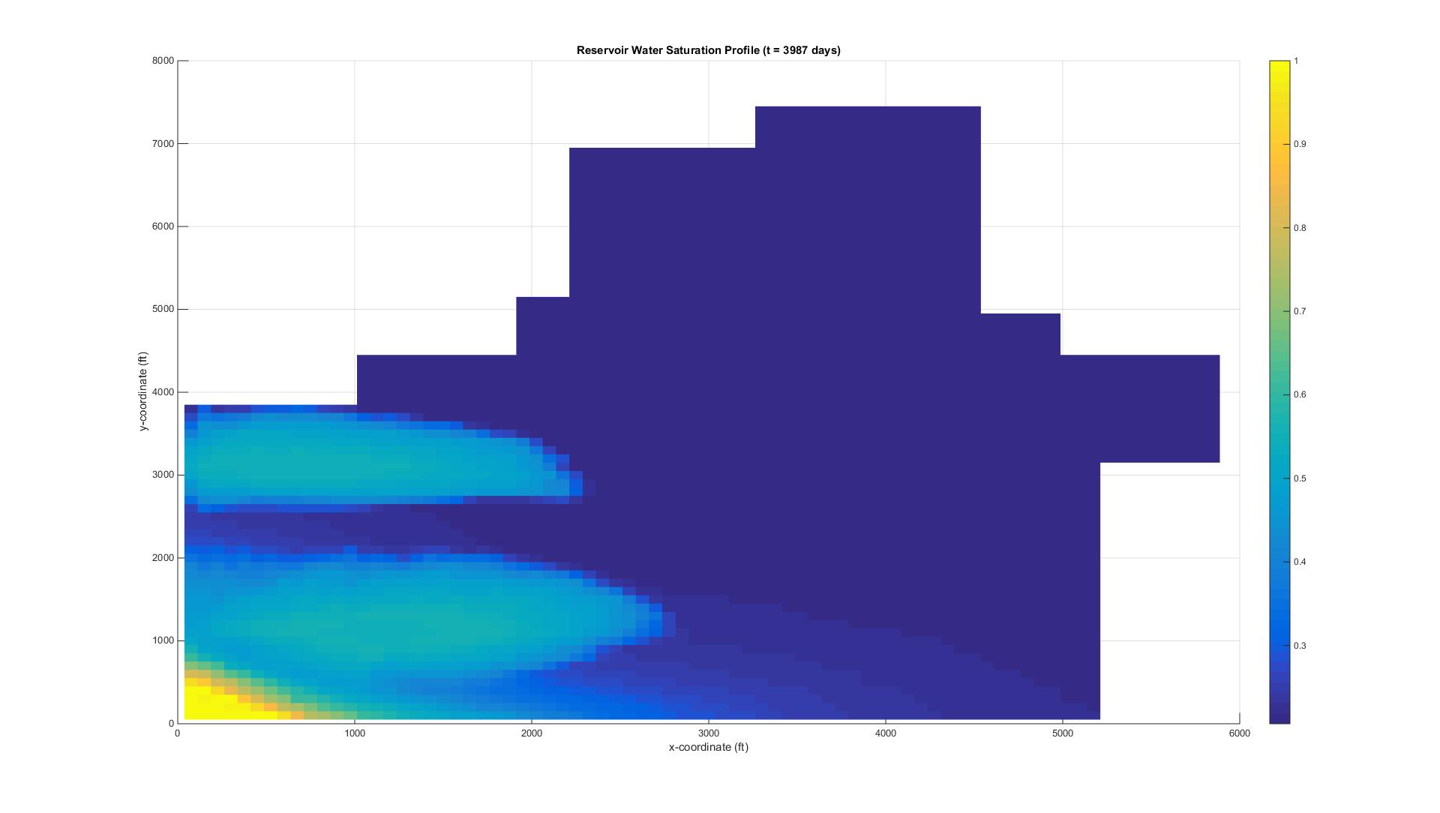
Saturation Profile @ 3987 days
% PrateekBhardwaj_Nechelik.m

Slide 13
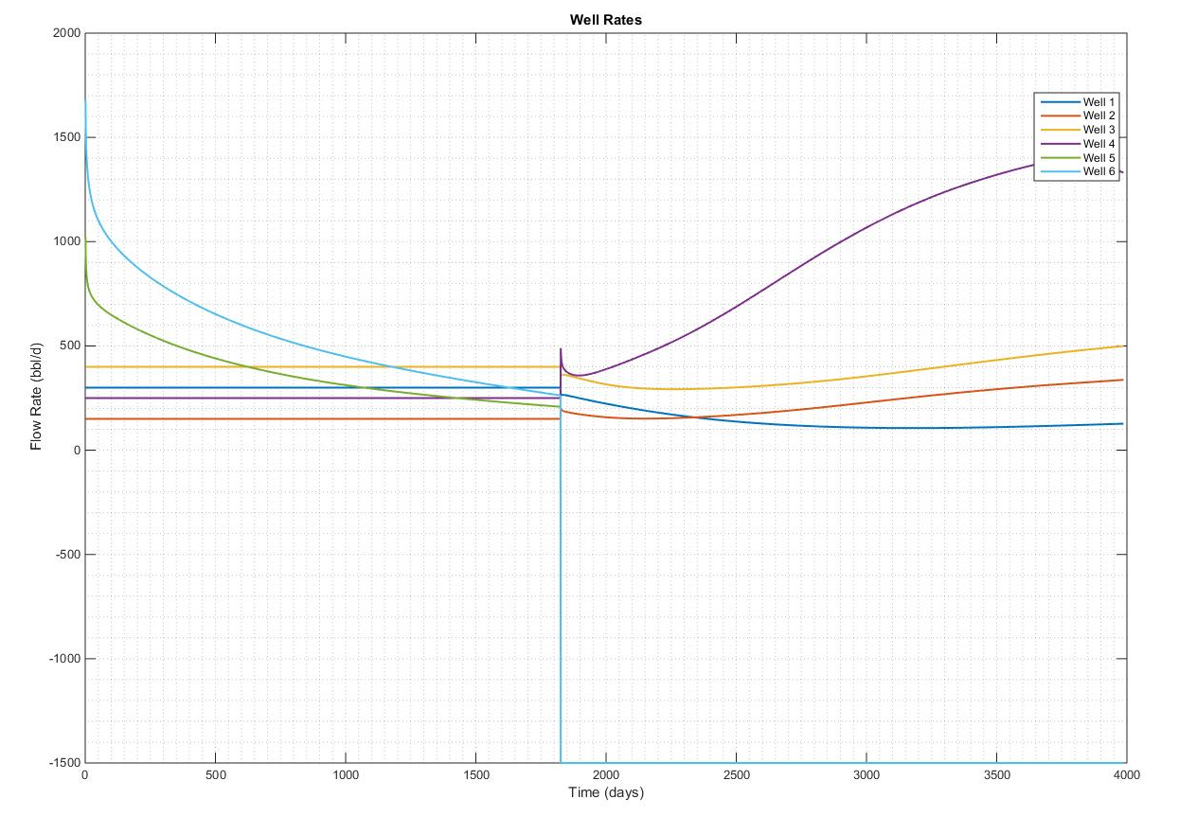
Well Rates
% PrateekBhardwaj_Nechelik.m
Schedule Change at 1826 days
WELL 5 and WELL 6 are both injecting water
Negative rates are considered as injection in this plot and positive are production rates

Slide 14
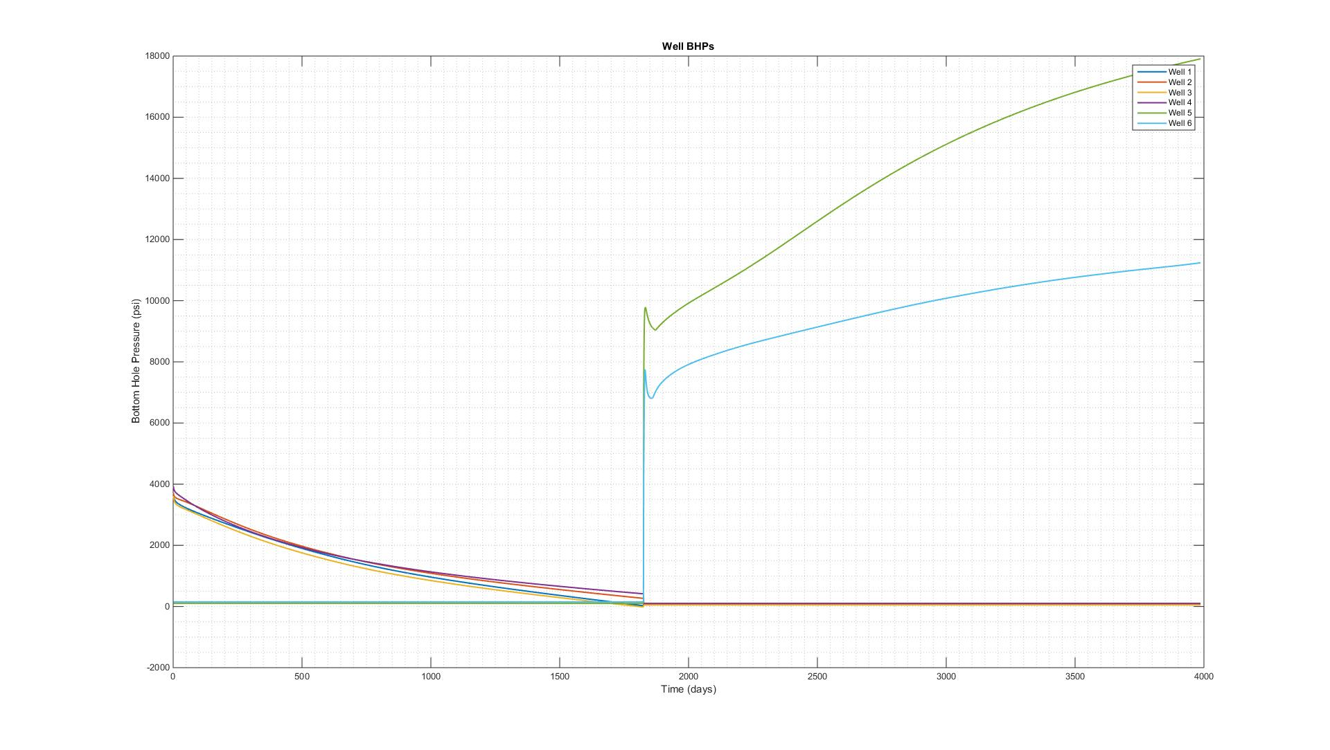
Well Bottom Hole Pressures
% PrateekBhardwaj_Nechelik.m
Schedule Change at 1826 days

Slide 15
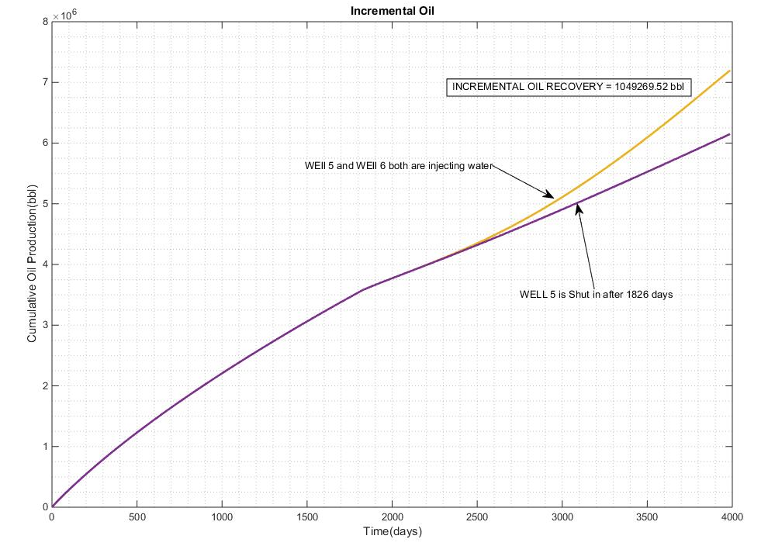
Incremental Oil Recovery
% PrateekBhardwaj_Nechelik_Shutin.m
Well 5 and Well 6 are both injecting water
Well 5 is Shut In after 1826 days

